Slide 1

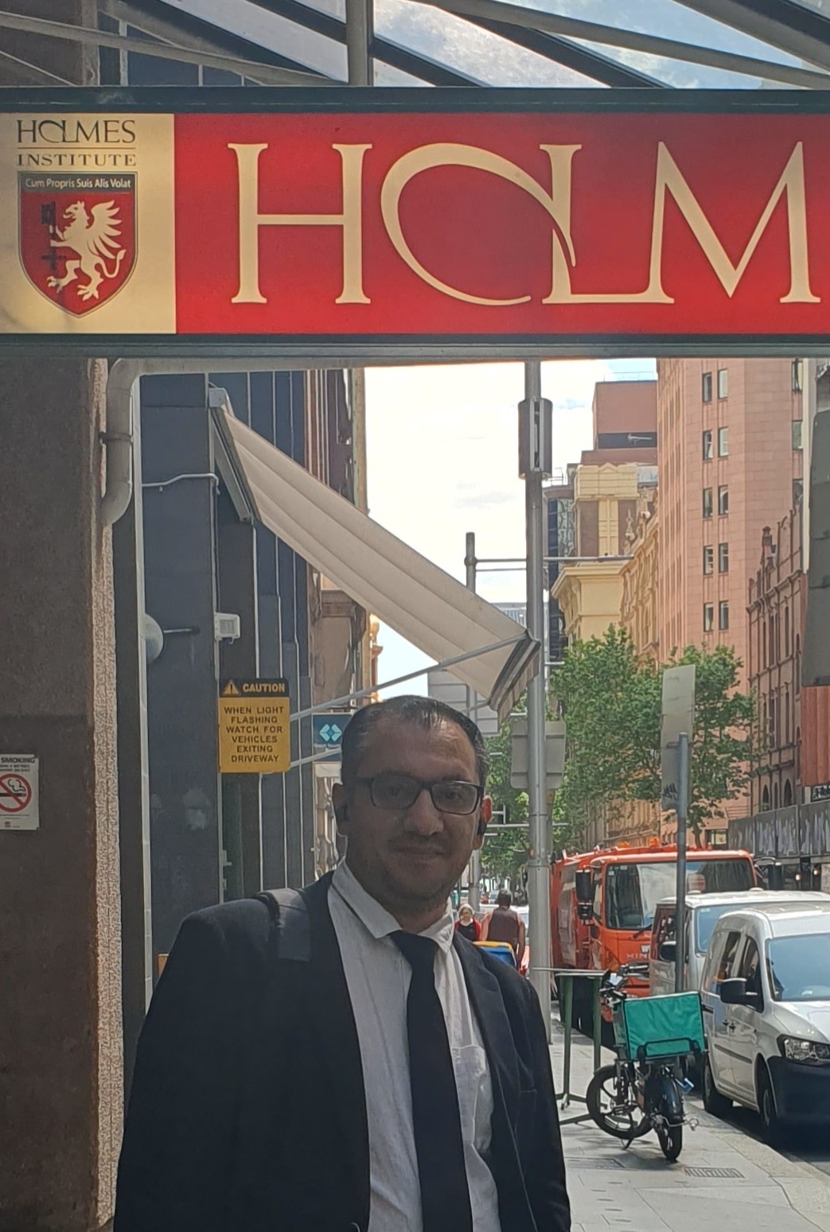
HI6040 (Artificial Intelligence and Machine Learning)
Dr. Farshid Keivanian
Tutorial Week 8

Slide 2
Outline
Group Class Facilitation for HI6040-S1-T2.2025 (Sydney Campus)
What Students Should Do in Week 8
Example 1: Clustering the Iris Dataset: K-Means
Activity 1: Show the Cluster Centers in K-Means
Activity 2: Change the marker/size
Activity 3: Show centers for k=4
Activity 4: Compare sepal vs petal features
Activity 5: Change k and observe
Activity 6: Try different features
Activity 7: Standardize then cluster
Example 2: Choosing k: Elbow & Silhouette
Example 3: DBSCAN: Clustering by Density
Activity 8: Tune eps
Activity 9: Compare to K-Means
Activity 10: Standardization effect

Slide 3
Group Class Facilitation for HI6040-S1-T2.2025 (Sydney Campus)
For the Group Class Facilitation assessment (worth 30%), your group must select a topic and email it to me for approval.
In addition, each group must book a time slot for your presentation session. Please use the following link to book your slot:
Presentation Schedule for HI6040-2025 (Sydney S1).xlsx

Slide 4
Group Class Facilitation for HI6040-S1-T2.2025 (Sydney Campus)
Important guidelines:
Each group must choose a topic (from the proposed AI/ML areas) and obtain approval by email.
Time slots are allocated on a first-come, first-served basis.
Enter your group’s details directly into the booking sheet.
Each group presents only once, in their allocated week (Weeks 5–11).
Each student is expected to present for about 5 minutes.
Your slides must be submitted on Blackboard before your facilitation session (one submission per group).
After booking, please send me a confirmation email.

Slide 5
What Students Should Do in Week 8
Prepare one slide (as per the group assessment) with:
A short example of unsupervised learning (preferably clustering).
A simple diagram, dataset visualization, or result (scatter plot).
2–3 questions for class discussion (not just answers).
A 2-minute summary of what they learned.

Slide 6
What Students Should Do in Week 8
Present a simple case:
Load data (e.g., Iris dataset from sklearn).
Run K-Means clustering or PCA (dimensionality reduction).
Show the result visually (clusters on a scatter plot).

Slide 7
Example 1: Clustering the Iris Dataset: K-Means
Goal: Group flowers into 3 clusters without labels.
Tool: K-Means (partition data into k groups by minimizing distance to each group’s center).
Data: Iris sepal length & width (2 features so we can plot).

Slide 8
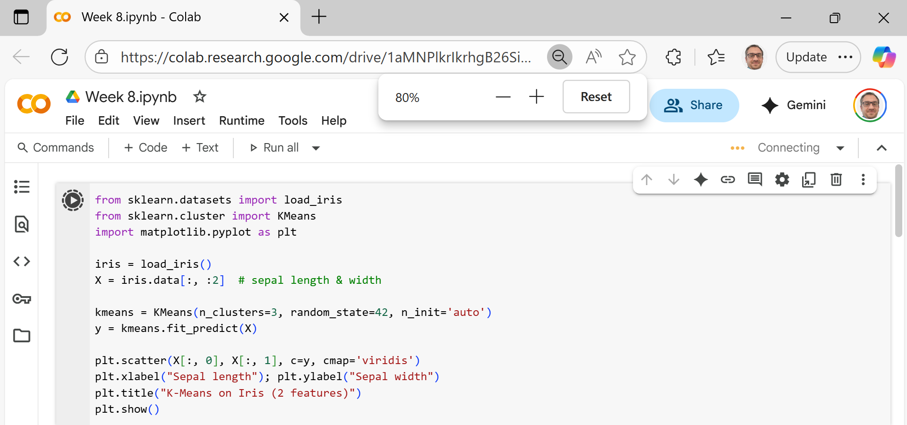
Example 1: Clustering the Iris Dataset: K-Means
Load data → get two columns (sepal length/width).
Pick k → we choose k = 3 (we expect 3 species).
Fit K-Means → the algorithm places 3 centers, assigns each point to the nearest center, and repeats until centers stop moving.
Get labels → each point now has a cluster ID (0/1/2).
Plot → color points by their cluster to see the groups.

Slide 9
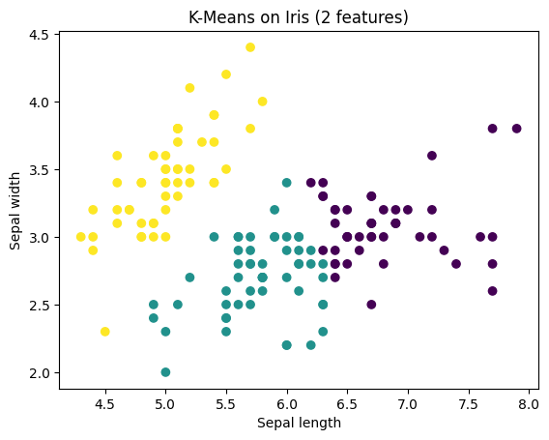
Example 1: Clustering the Iris Dataset: K-Means
Explain of Results:
Each color = a cluster found by K-Means.
Centers (not shown) are the “average” point of each cluster.
K-Means works best when clusters are roundish and similar size

Slide 10

Activity 1: Show the Cluster Centers in K-Means
Activity Prompt (for students)
You have a scatter plot of Iris clusters.
But… where are the cluster centers?
Think: What line of code could you add to mark them with a red “X”? (Hint: the fitted KMeans object has something stored about centers…)

Slide 11
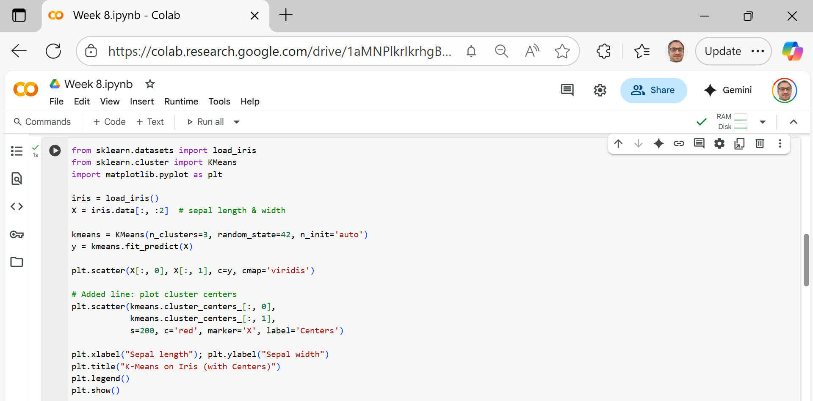
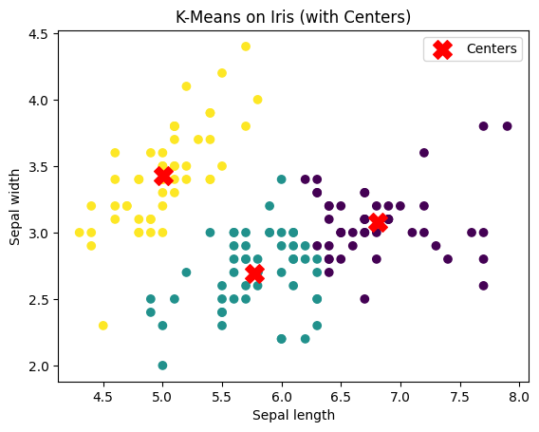
Activity 1: Show the Cluster Centers in K-Means
New Line
kmeans.cluster_centers_ → stores the coordinates of the cluster centers.
[:, 0] and [:, 1] → grab the x and y coordinates.
s=200 → makes the marker bigger.
c='red', marker='X' → makes centers stand out as red X’s.
label='Centers' → so the legend explains what the X’s are.

Slide 12
Activity 2: Change the marker/size
Try marker='*', s=300.
Question: Which is easier to see, star or X?

Slide 13
Activity 3: Show centers for k=4
Change n_clusters=4.
Question: How many centers appear? Where are they?

Slide 14
Activity 4: Compare sepal vs petal features
Plot again with iris.data[:, 2:4].
Question: Do the cluster centers move closer to “real species” separation?

Slide 15
Activity 5: Change k and observe
Try n_clusters=2, then 4.
What to note: With too few clusters, groups mix; with too many, one natural group gets split.

Slide 16
Activity 6: Try different features
Use petal features: iris.data[:, 2:4].
What to note: Petal features separate species more clearly → cleaner clusters.

Slide 17
Activity 7: Standardize then cluster
from sklearn.preprocessing import StandardScaler
Xz = StandardScaler().fit_transform(iris.data[:, :2])
y2 = KMeans(n_clusters=3, random_state=42, n_init='auto').fit_predict(Xz)
What to note: Scaling avoids one feature dominating distance.

Slide 18
Example 2: Choosing k: Elbow & Silhouette
How Many Clusters? Elbow + Silhouette on Iris
Try many k values (e.g., 2–8).
Elbow: Record inertia (sum of squared distances). Plot inertia vs k → look for the “elbow” (diminishing returns).
Silhouette: Score how well points fit their cluster vs. others (−1 to 1). Higher is better.
Why we do this
K-Means needs you to choose k (the number of clusters).
But how do we know the best k?
Two popular ways: Elbow (look for bend in error curve) and Silhouette (score cluster quality).

Slide 19
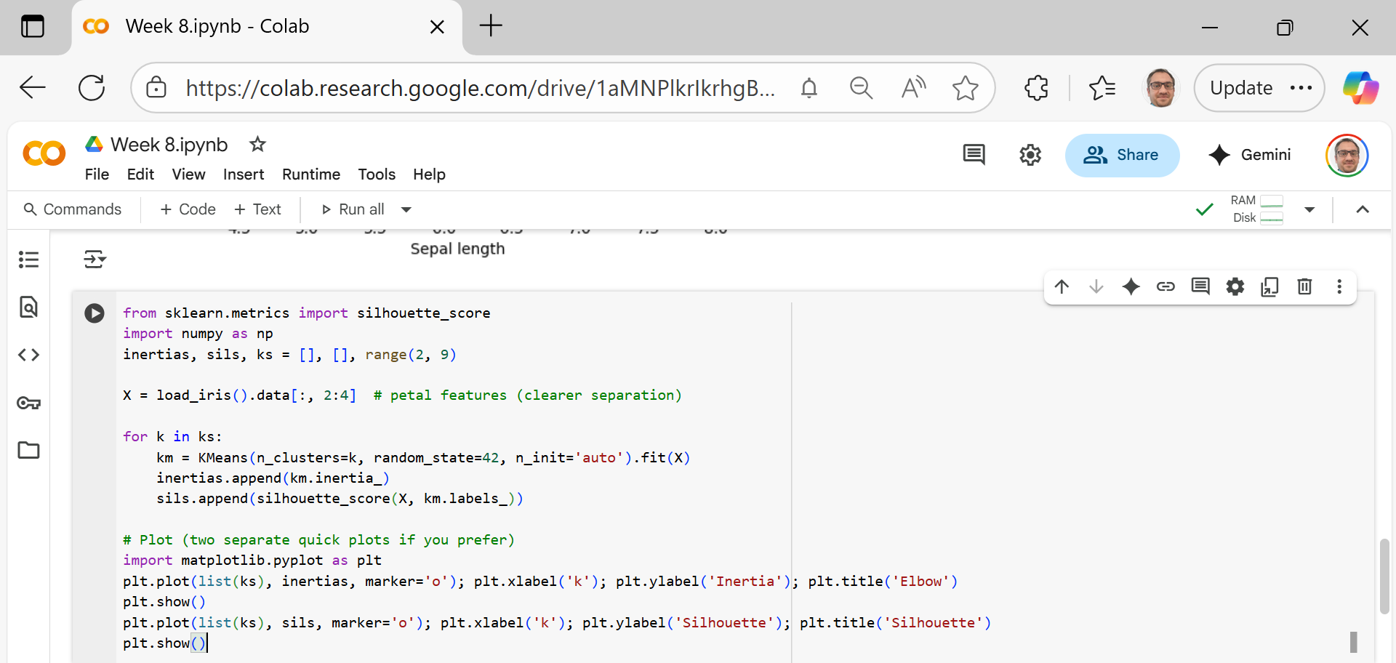
Prepare data
Use only petal length & width → easier to see separation.
Try different k values
Loop k = 2 to 8.
For each k:
Run K-Means.
Save the inertia (distance of points to their centers).
Save the silhouette score (how well points fit in their cluster vs others).

Slide 20
Plot Elbow
Inertia decreases as k increases.
The “elbow point” (bend in the line) suggests a good k.
Plot Silhouette
Higher silhouette score = better clustering.
The best k usually has the highest score.

Slide 21
Key Takeaways for Students
Elbow method: Too few clusters → error high; too many clusters → no big improvement.
Silhouette method: Balances cohesion (tight clusters) and separation (clusters far apart).
On Iris petals, both usually point to k ≈ 3.

Slide 22
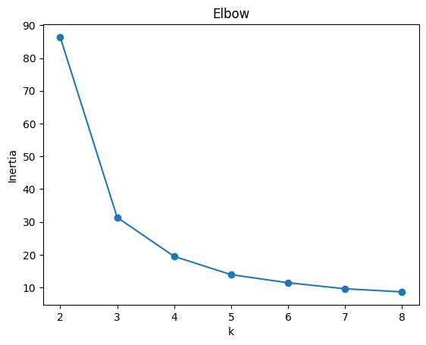
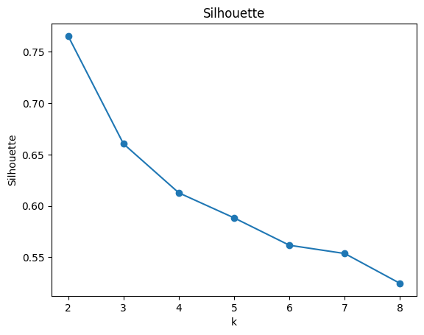
Elbow plot: The biggest drop in inertia happens from k=2 → k=3. After k=3, the curve flattens, meaning extra clusters don’t add much value.
Silhouette plot: The score is highest at k=2, but k=3 is also strong and aligns better with the natural three Iris species.
Conclusion: Both methods suggest k=3 is a good balance (close to biology), even though silhouette peaks at 2.
Why might silhouette suggest 2 but elbow suggest 3? Which would you trust here?

Slide 23
Example 3: DBSCAN: Clustering by Density
DBSCAN: Find Clusters (and Noise) Without Choosing k
Why this example
No need to choose k.
Finds oddly shaped clusters and can mark noise.
Shows contrast with K-Means’ round-cluster bias.

Slide 24
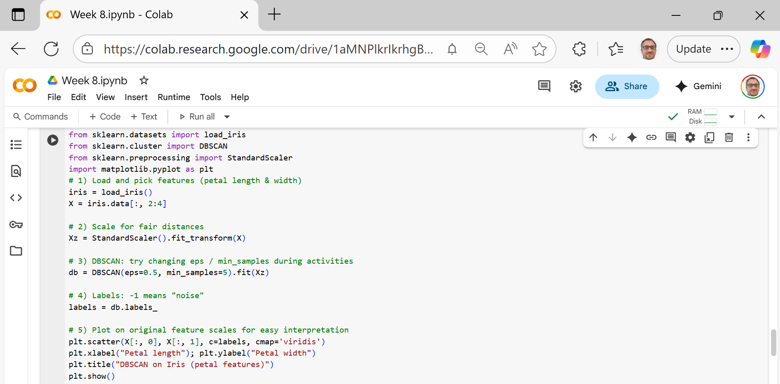
Load data Use Iris petal length & width (they separate species better).
Scale features DBSCAN uses distances. We standardize so both features contribute fairly.
Pick DBSCAN knobs
eps: how close points must be to be “neighbors” (radius in scaled units).
min_samples: how many neighbors make a spot “dense” (including itself).

Slide 25
Run DBSCAN It groups points in dense areas into clusters; sparse points become noise.
Read labels labels = db.labels_ → cluster IDs 0,1,…; noise = −1.
Plot Show petal length (x) vs petal width (y), color by labels to see clusters/noise.

Slide 26
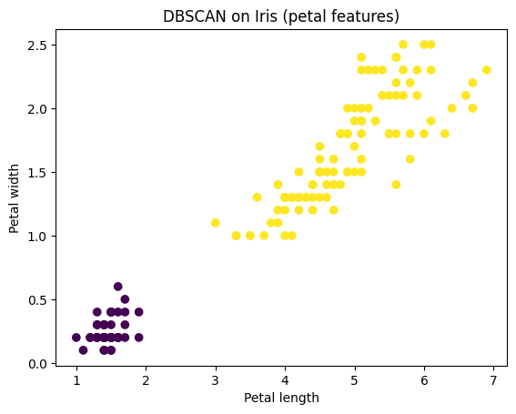
DBSCAN found two main clusters in the Iris petal data — one small, tight cluster on the left and one larger cluster on the right — showing it can group dense regions without needing you to set k in advance.

Slide 27
Activity 8: Tune eps
Do: Try eps = 0.3, 0.5, 0.7.
Notice: Smaller eps → more clusters/noise; larger eps → clusters merge.

Slide 28
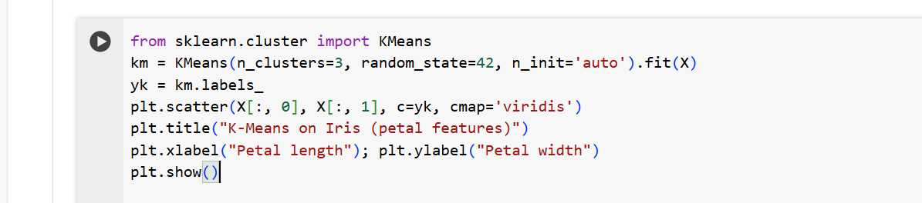
Activity 9: Compare to K-Means
Do: Run K-Means on the same features (X) and plot its labels.
Notice: K-Means forces exactly k clusters; DBSCAN can find shapes and mark noise.

Slide 29
Activity 10: Standardization effect
Do: Run DBSCAN without scaling (use X instead of Xz), then with scaling.
Notice: Results change a lot without scaling → distance-based methods need scaling.

Slide 30
Thank You
Need Help with coding? Send an email or ask during the tutorial session.
FKeivanian@my.holmes.edu.au

